Slide 1
Lab 03 Basic Widgets
By
M.Zakir Khan

Slide 2
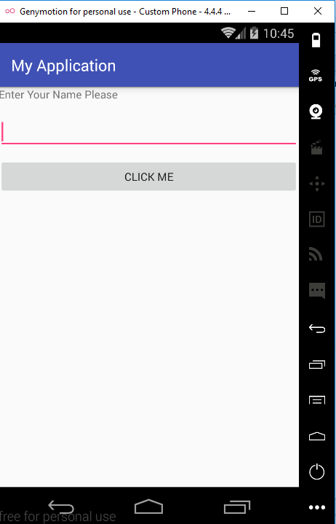
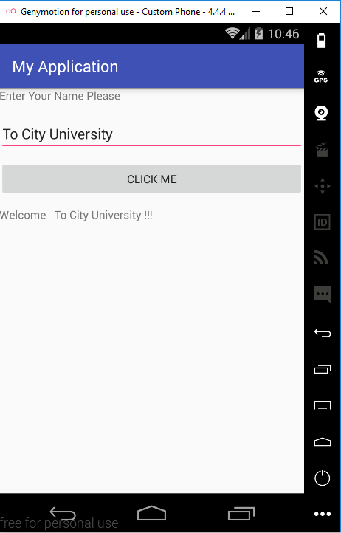
Activity Implementing the onClickListener Interface

Slide 3
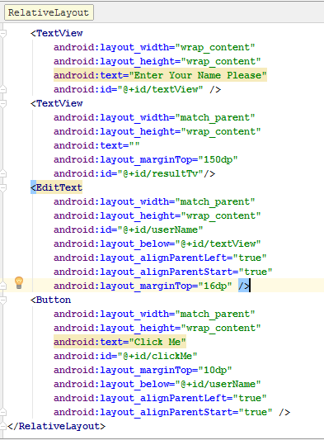
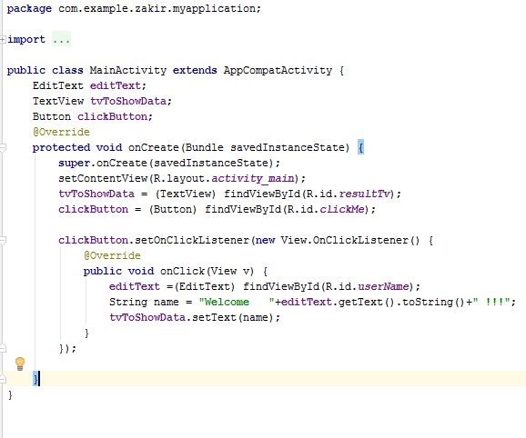
XML code and JAVA code

Slide 4
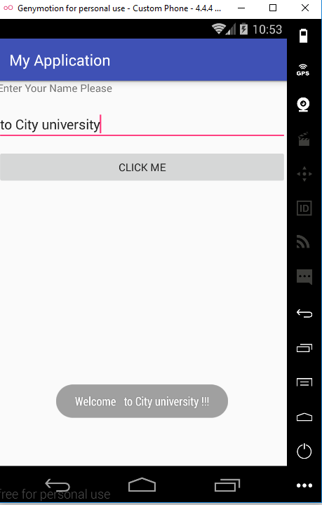
Displaying Message through Toast

Slide 5
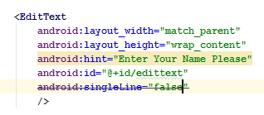
Using the EditText Control
The Edittext is the subclass of TextView and is used for getting input from the user.
Several attributes can be used to configure the Edittext to suit your requirements.
For example We can implement the scrolling feature to scroll the text when user type beyond the width or auto text feature to correct common spelling mistake.

Slide 6
Attributes used to configure the EditText Control Try it Now
android:layout_width (the two valid values are wrap_content and match parent)
android:layout_height (the two valid values are wrap_content and match parent)
android:singleLine (when set to true, forces the Edittext control to remain on single line and when set false then the cursor move to the next line)
android:hint (Displaying helpul text to guide the user during entry)
android:lines (when we set android:lines=“5” set the Edittext height control to accommodate to five lines)
android:textSize (set the size of text typed inEdittext control)

Slide 7
Attributes used to configure the EditText Control Try it Now
android:autoText (When set true enables the edittext control to correct common spelling mistakes)
android:capatalize (Automatically convert the typed text into capital letters)
android:password (it hide the enter text to dot)
android:minWidth (specify the minimum width of the control)
android:maxHeight
android:maxWidth
android:scrollHorizontally (make the text scroll hoirzontally)

Slide 8
Android:inputType
Specify the type of data that will be type in Edittext control.
This attribute configure the onscreen keyboard too.
There are many possible values that include
Number
Phone
Text
textCapCharacters
textCapWords
textEmailAddress
dateTime
Date
Time
textAutoCorrect
textMultiLine
textPassword

Slide 9
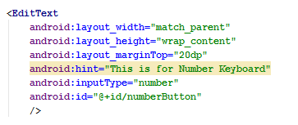
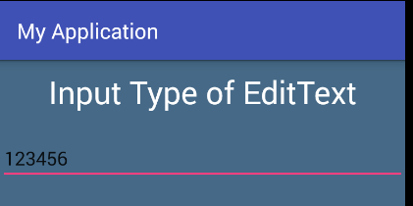
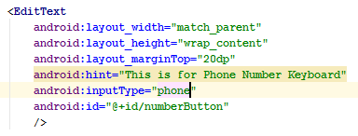
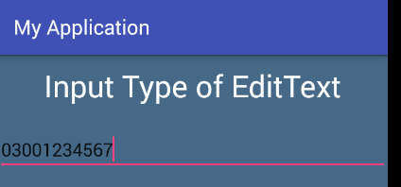
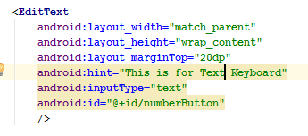
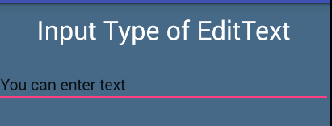

Slide 10
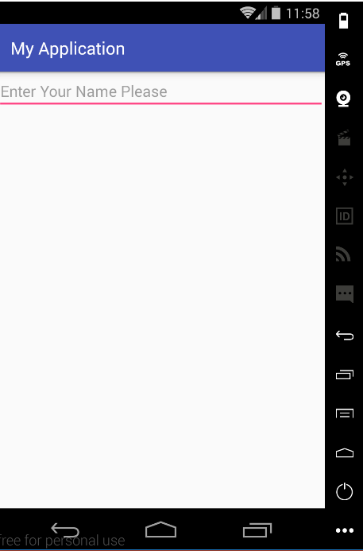
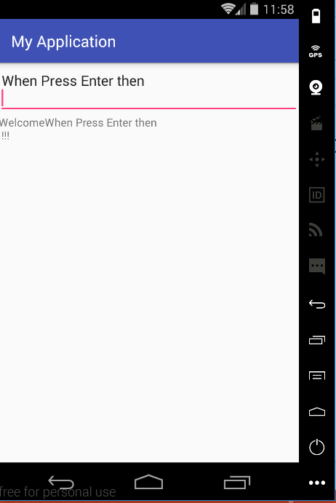
Adding EventListener to Edittext Control

Slide 11
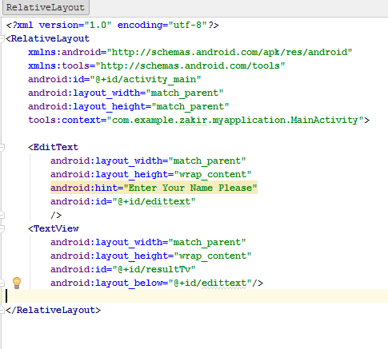
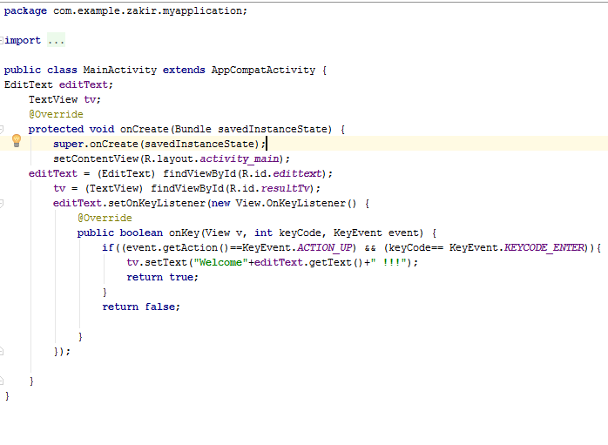
XML code and Java code

Slide 12
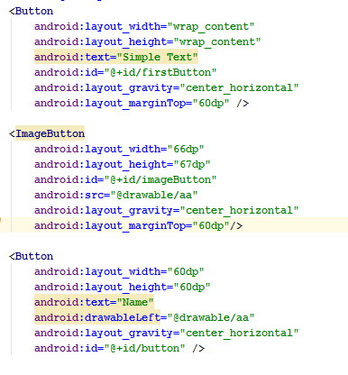
Input Control Button
We can represent the Button on three different way like shown

Slide 13
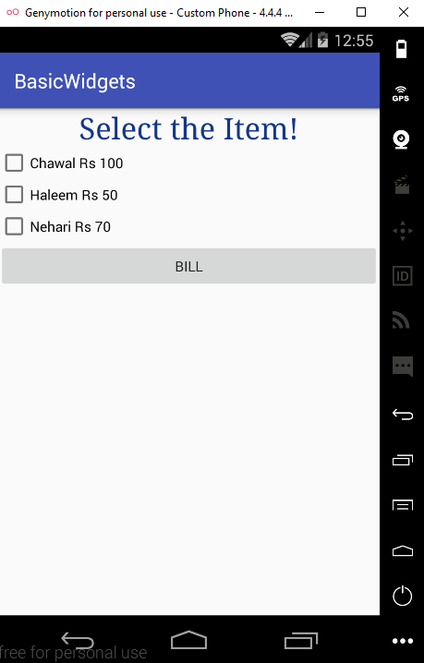
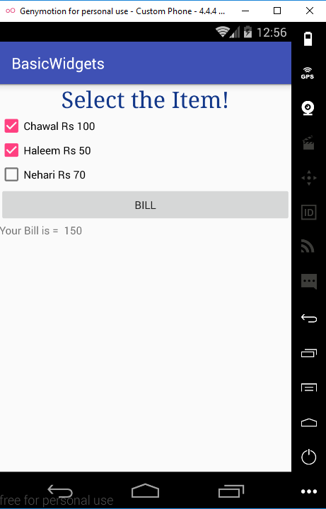

CheckBox control

Slide 14
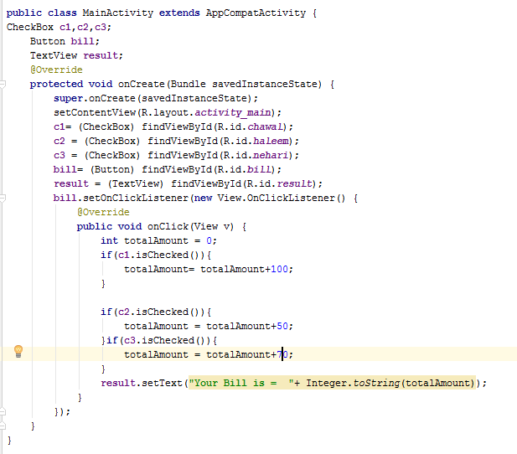
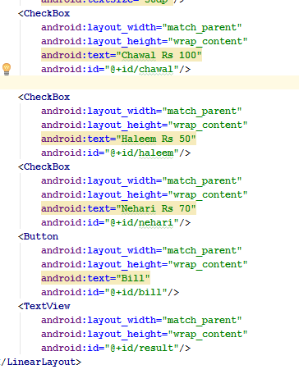
XML and JAVA code

Slide 15
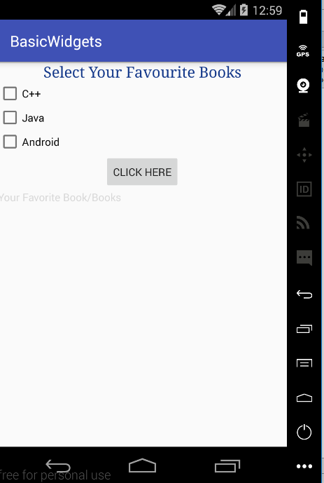
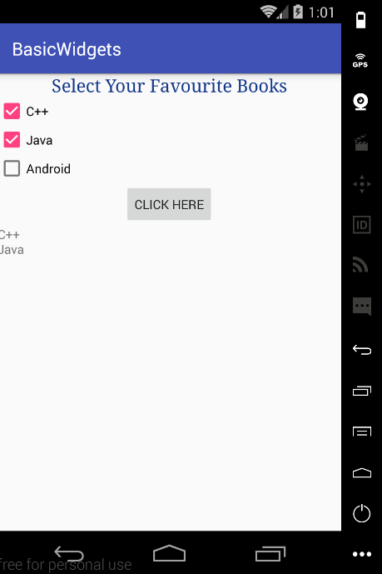
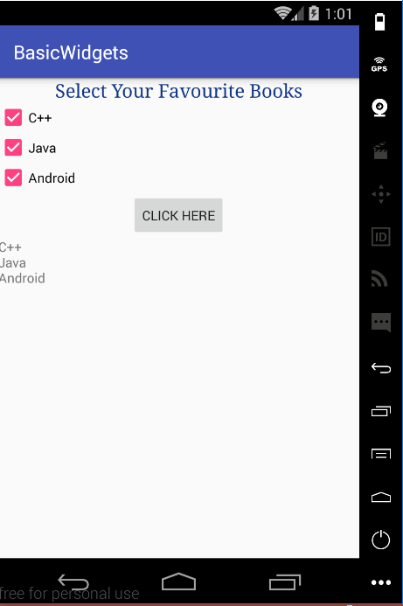
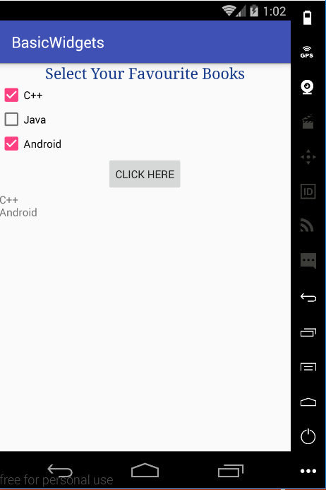
Checkbox (Example 2)

Slide 16
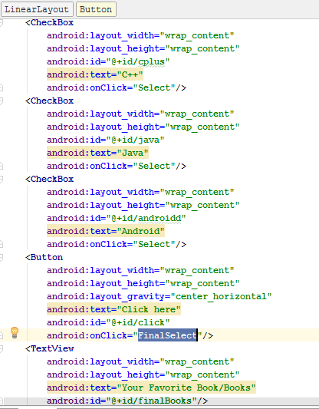
XML Code

Slide 17
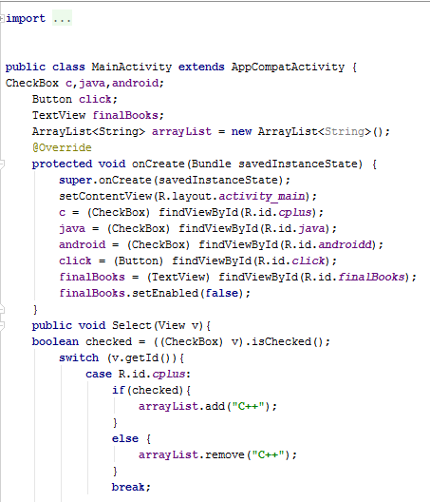
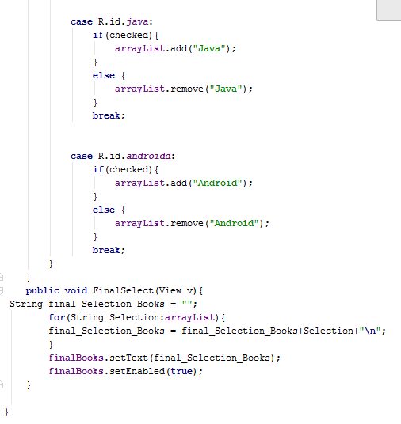
Java Code

Slide 18
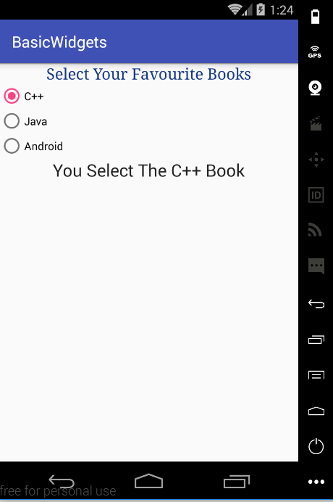
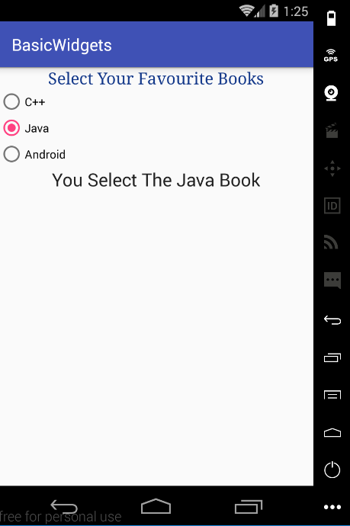
Radio Button

Slide 19
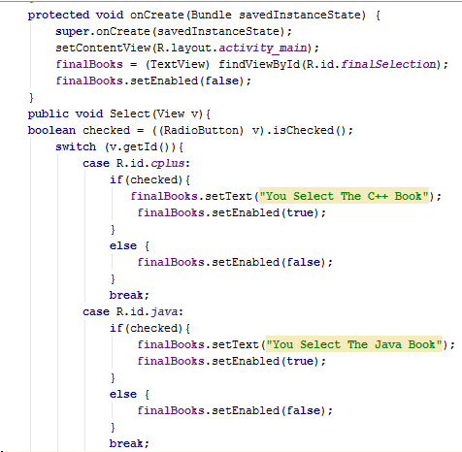
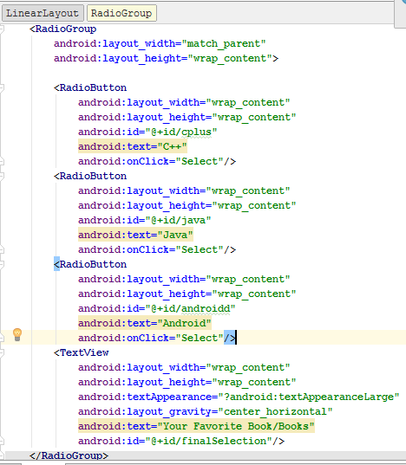
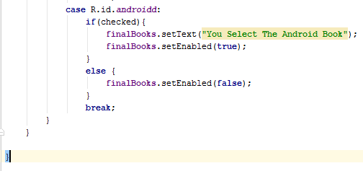
XML and JAVA code

Slide 20
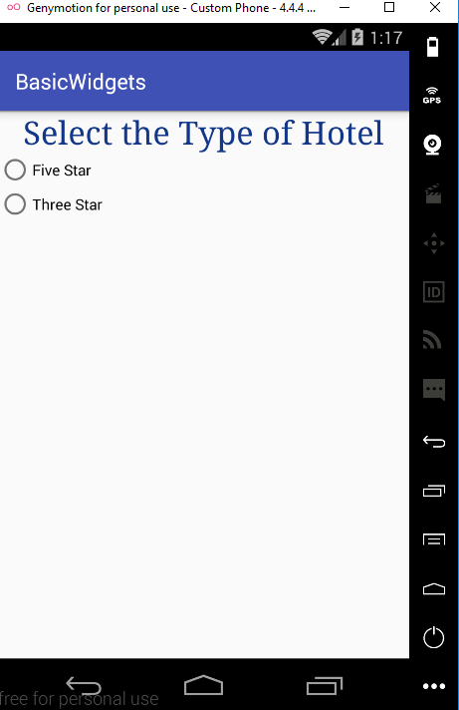
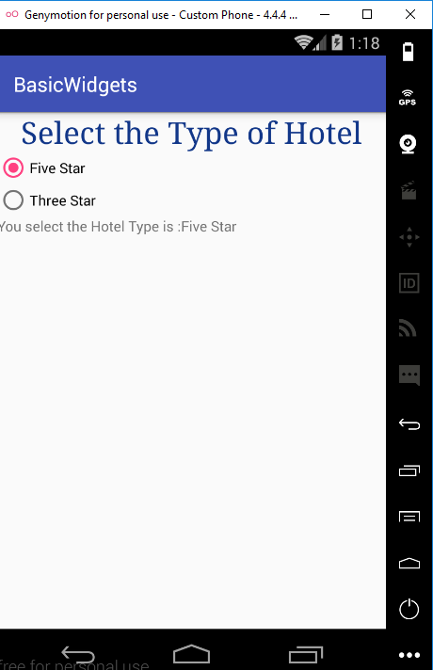

Radio Button

Slide 21
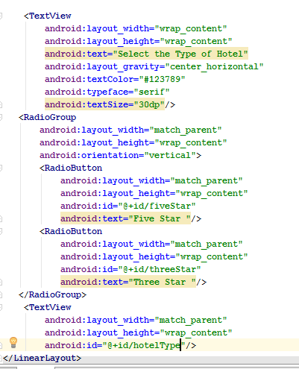
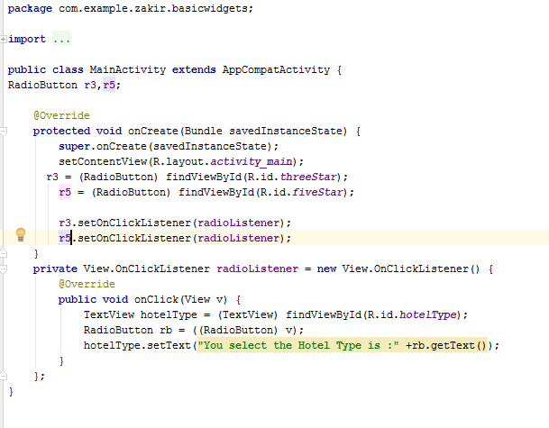
XML and JAVA code

Slide 22
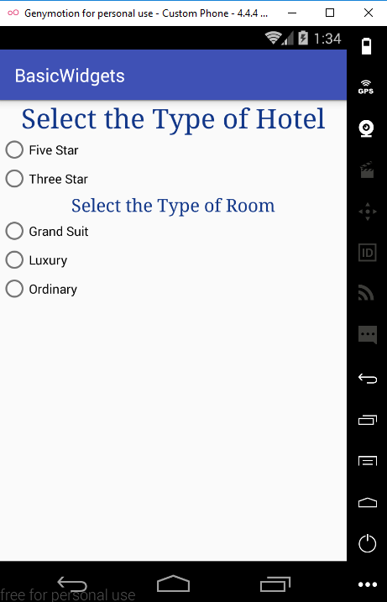
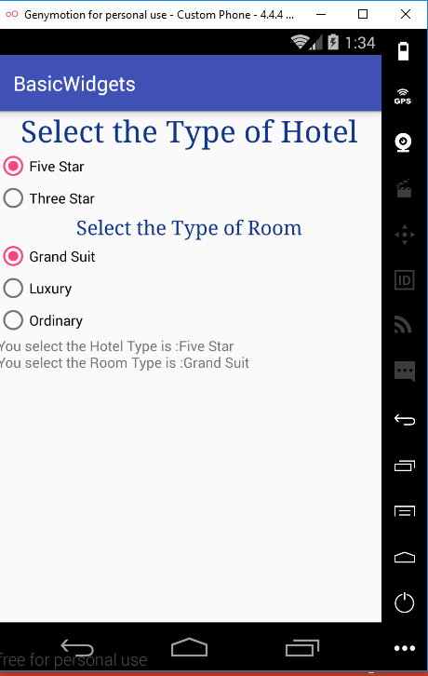
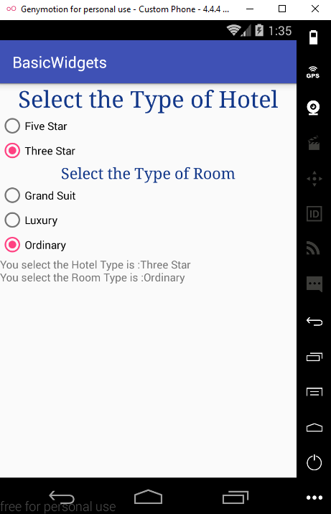
Radio Button Example 2 Task

